Slide 1
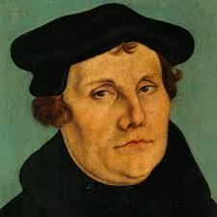

Slide 2
Martin Luther born November 10th 1483 and he died February 18, 1546. he was a Christian theologian and Augustinian monk, whose teachings inspired the Protestant Reformation and deeply influenced the Christian traditions. Martin Luther was born in Germany and was baptized there.

Slide 3
Martin Luther had a church named after him. He was called to the Church to return to the teachings of the Bible resulted in the formation of new traditions within Christianity and the Counter Reformation in the Catholic Church, from the Council of Trent.

Slide 4
His translation of the Bible also helped to develop a standard version of the German language and added several principles to the work of translation. Luther's hymns sparked the development of congregation singing in Christianity. His marriage, on June 13, 1525, to Katharina von Bora a former nun began the tradition of orthodox marriage within several Christian traditions.

Slide 5
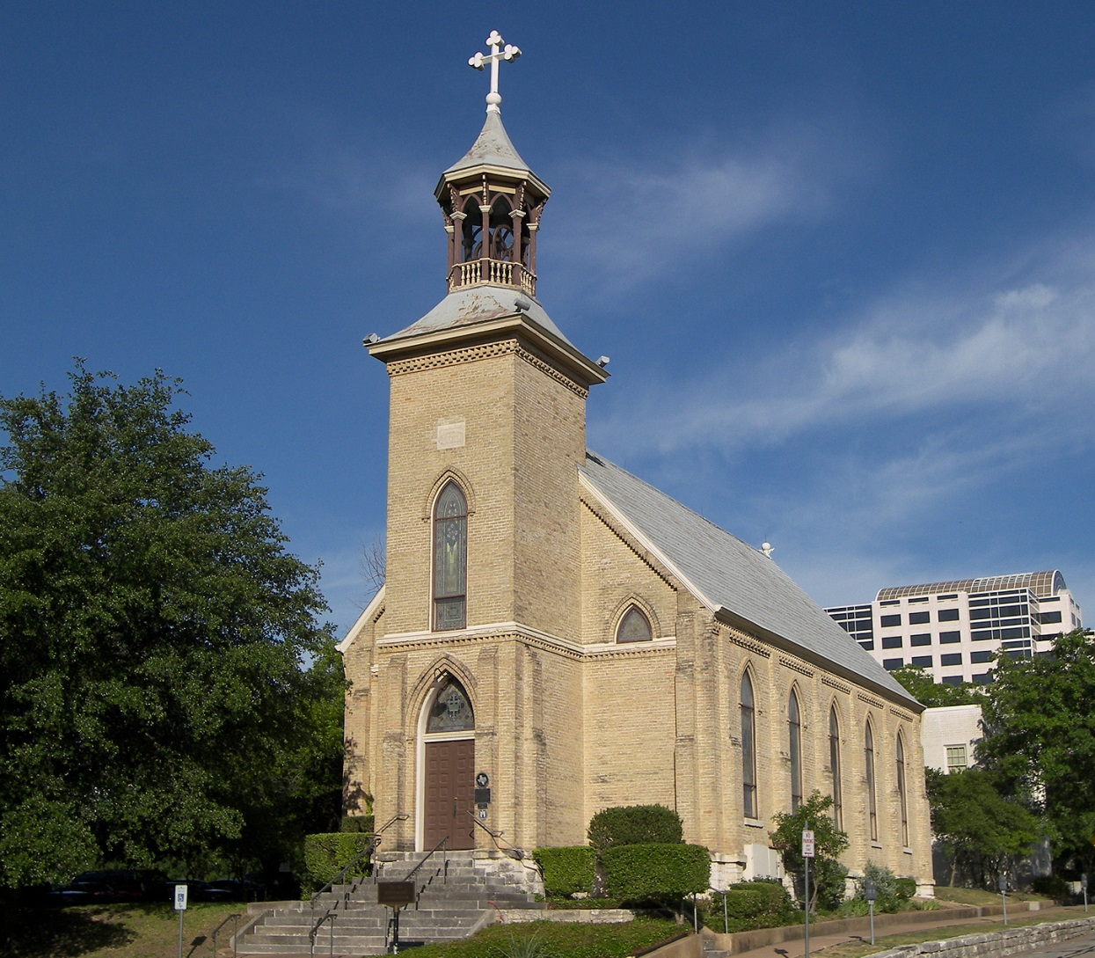

Slide 6
Luther’s books explain the settings of the epistles and show the correspondence to the books in the Bible. Luther also wrote about church administration and wrote much about the Christian home. Luther's work contains a number of statements that modern readers would consider vividly rude. For example Luther was know to advise people that they should “tell the Devil he may kiss my ass”. It is remembered that Luther received many communications throughout Europe from people who could write anonymously, that is, without the media making their communications known.

Slide 7
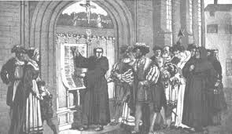

Slide 8
Luther primarily preached towards the Jewish people, convinced that the reason they had never converted to Christianity was that they were justified against or had never heard the Gospel of Christ. However, after his preaching to the Jews failed to convince Jewish people to adopt Christianity, he began preaching that the Jews were set in there anti-Christian ways, and needed to be expelled from German politics. Luther repeatedly quotes the words of Jesus in Matthew 12:34 where Jesus called them "a brood of vipers and children of the devil"

Slide 9
Luther was devout toward the Gospel, and he wanted to protect the people from the Jews who he believed would be terrifying influences since they did not recognize Jesus as their Savior. In Luther's time parents had a right and a duty to direct their children's marriage choices in respect to matters of faith. Likewise, Luther felt a duty to direct his German people to stay true to Jesus the Jews did not agree . It should be known that church law was adamant to civil law in Luther's day and that law said the penalty of blasphemy was death.

Slide 10
Martin Luther died of natural causes. His last written words were "Know that no one can have indulged in the Holy Writers sufficiently, unless he has governed churches for a hundred years with the prophets, such as Elijah and Elisha, John the Baptist, Christ and the apostles... We are beggars”

Slide 11
