Slide 1
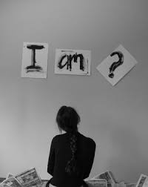
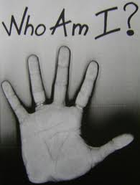
My name is Kim Howard

Slide 2
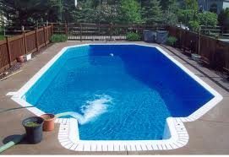
Were you grow up
Indianapolis Indiana

Slide 3
The schools I went to
in 7th grade I wen to Riverview
in 8th grade I went to bennion
in 9th grade I went to Kennedy
in10th grade I go to Ames

Slide 4
The type of music I listen to
I pretty much listen to all kinds I'm more of an oldies kind of person I just fill like there music makes a lot more since and they don’t make up words like most song theses days but that’s just me

Slide 5
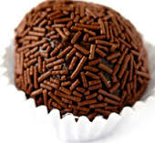
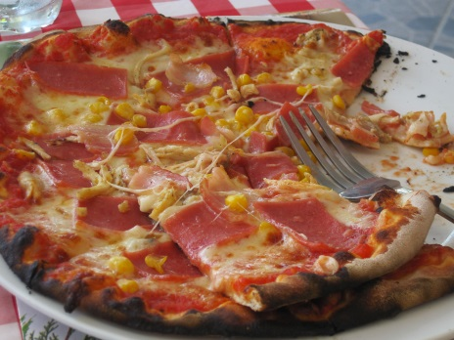
My favorite foods
Brazilin
Dominican
pizza

Slide 6
My hobbies
soccer
Football
Singing
Dance

Slide 7
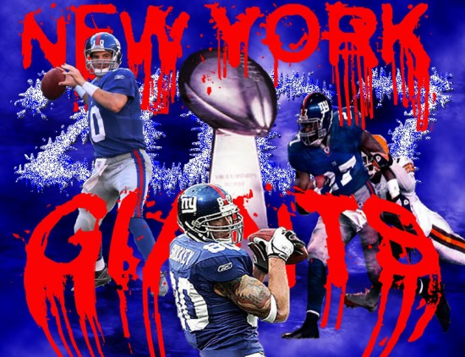
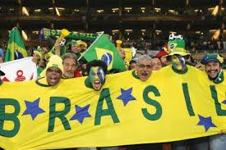
My favorite teams
Ravens and giants ( football)
brazil and real (soccer)

Slide 8
My grade goals
A’s and B’s

Slide 9
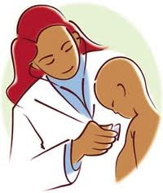
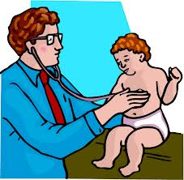
My plans for school
after I graduate I will go to college for my PhD. to become a pediatrician or a pediatric pa .

